Slide 1
Paying for College
Show me the MONEY!

Slide 2
Needs-based Scholarships
Family can not afford college based on FAFSA info

Slide 3
Merit-based Scholarships
May or may not need a separate application to apply for this type of funding/ check with individual college financial website or contact admissions officer
Accomplishments earn this type of funding
GPA
SAT/ACT scores
athletics

Slide 4
Needs-blind Scholarships
Does not look at family financial need
ALWAYS need an application and/or essays to apply for these!
Plan early and manage your time to ensure you are applying to enough to cover the costs of college!

Slide 5
Grants
$$ that does NOT need to be payed back
Typically awarded through your FAFSA info

Slide 6
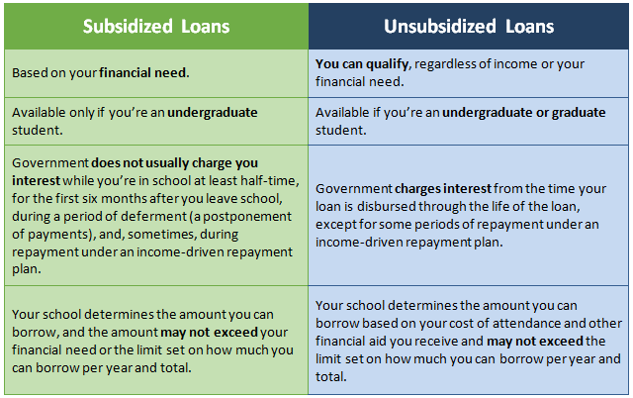
Loans

Slide 7
Parent PLUS loans
Loan offered to parent of student to help pay for college

Slide 8
Work Study
Job on campus to help off-set cost of college

Slide 9
Individuals can ACCEPT or DENY ALL of the offers for financial assistance!

